Slide 1

Dash
Dine
AND

Slide 2
NUTRITIONAL VALUE: RAW FOOD
Calories
Mineral
Vitamin
Macronutrient

Slide 3

What to do when
Dash And Dine!
Food & NUTRITION
Starving!
Don’t Know what to eat!

Slide 4

What to do when
Dash And Dine!
Food & NUTRITION
Starving!
Inconvenient ingredients worries you ?

Slide 5

What to do when
Dash And Dine!
Food & NUTRITION
Starving!
Dash And Dine!

Slide 6
Getting Desired Food
01
02
03
favorite ingredients
Quality
Menus
04
05
Preparation
Food
Dash And Dine!
Food & NUTRITION
desired ingredients
Choosing convenient meal
Sugar syrup, lentil flour
Time, Way of cocking
Dish information

Slide 7

Dash And Dine!
Application
Recommendation 1
Recommendation 2
Text
DashANDDine
Recommendation 3
Recommendation 4

Slide 8
Dash And Dine!
Preprocessing
Text
Preprocessing

Slide 9
Dash And Dine!
Preprocessing
Text
Preprocessing
Remove punctuations
Remove Digits
Remove content inside parenthesis
Convert to lowercase
Remove Stop Words and stemming

Slide 10
Dash And Dine!
POS and Dependency Tree
Text
Preprocessing
POS and Dependency Tree

Slide 11
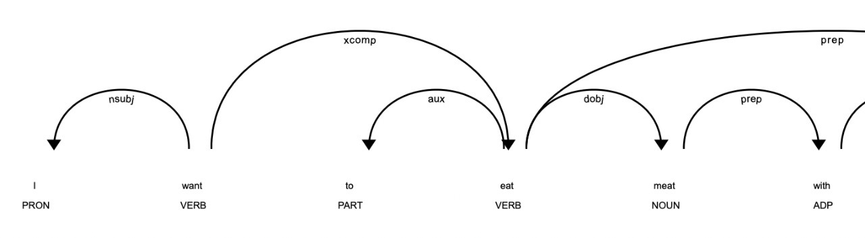
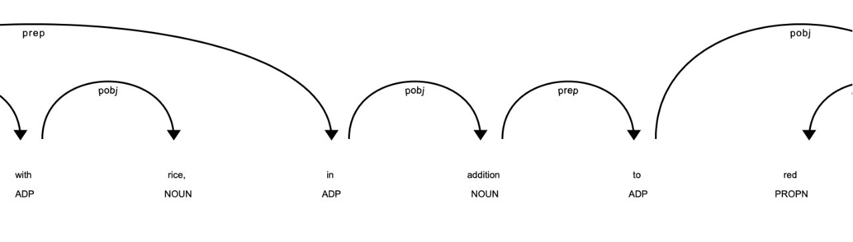
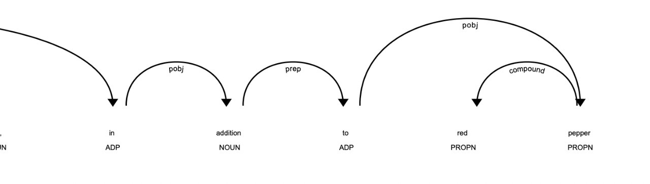
Dash And Dine!
POS and Dependency Tree
Text
Preprocessing
POS and Dependency Tree

Slide 12
Dash And Dine!
Premise entities extraction
Text
Preprocessing
POS and Dependency Tree
Premise entities extraction

Slide 13
Dash And Dine!
Premise entities extraction
Text
Input
Preprocessing
I want to eat meat with rice, in addition to red pepper.
POS and Dependency Tree
Output
Premise entities extraction
[meat, rice, addition, red pepper]

Slide 14
Dash And Dine!
FS-NER
Text
Preprocessing
POS and Dependency Tree
Premise entities extraction
Input: Entities
FS-NER

Slide 15
Dash And Dine!
FS-NER
Text
Input
{ "fruite“ : ["apple", 'avocado', 'banana', 'orange’],
"vegetable": ["carrot", "cabbage", 'broccoli’],
"meat“ : ["beef", "lamb", 'chicken’],
"fish": ["salamon", "shrimp", "tuna"],
"spices“ : ["angelica", "allspice", "cumin"],
"ingredient": ['oil', 'salt', 'sugar’],
"other": []}
Preprocessing
POS and Dependency Tree
Output
Premise entities extraction
FS-NER
Extract Entities

Slide 16
Dash And Dine!
Classification
Text
Preprocessing
POS and Dependency Tree
Passing extracted entities from FS-NER into Classifications Models
Premise entities extraction
Input: Entities
FS-NER
SVM
Random Forest
Logistic Regression

Slide 17
Dash And Dine!
Classification
Text
Preprocessing
POS and Dependency Tree
Premise entities extraction
Input: Entities
FS-NER
SVM
Random Forest
Logistic Regression
Cuisine Type prediction

Slide 18
Dash And Dine!
Classification
Text
Preprocessing
POS and Dependency Tree
Premise entities extraction
Input: Entities
FS-NER
SVM
Random Forest
Logistic Regression
Suggest Based Clustering

Slide 19
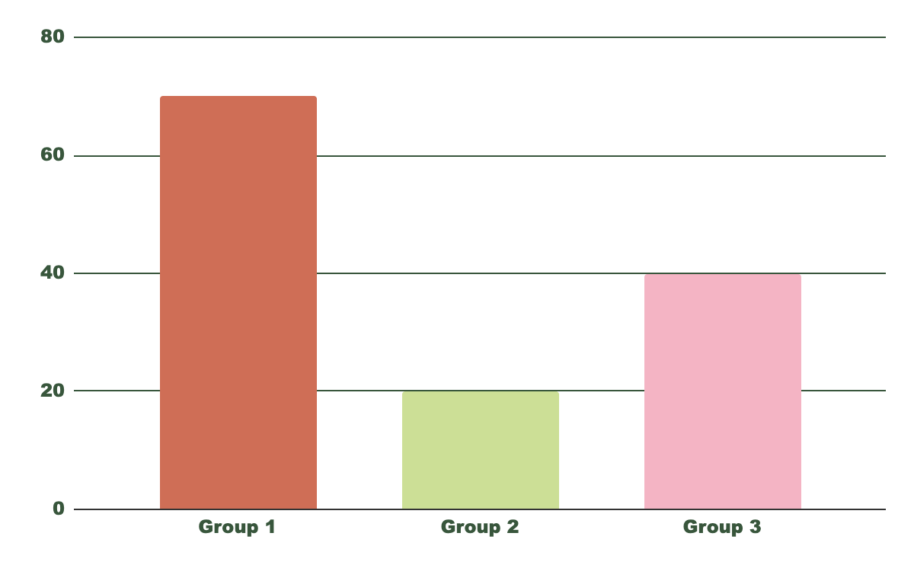

Classification Models
SVM
Random Forest
Logistic Regression
Dash And Dine!
Classification Models
80.6%
Accuracy
78.6%
Models
70.1%
Champion Model

Slide 20
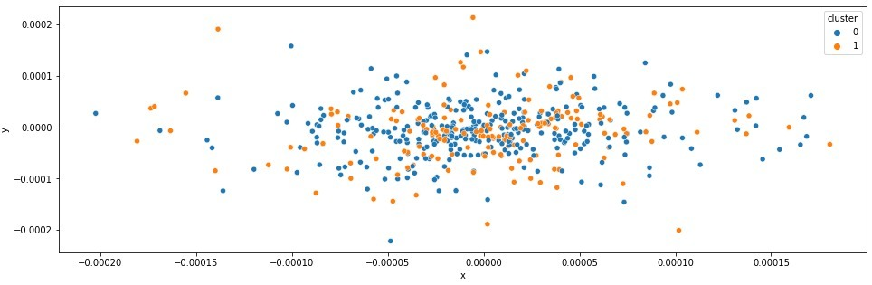
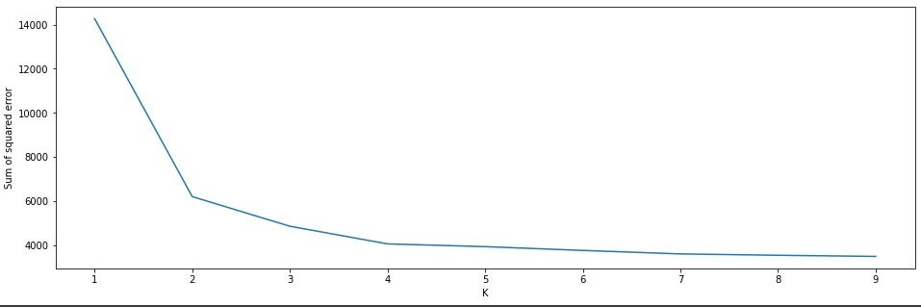
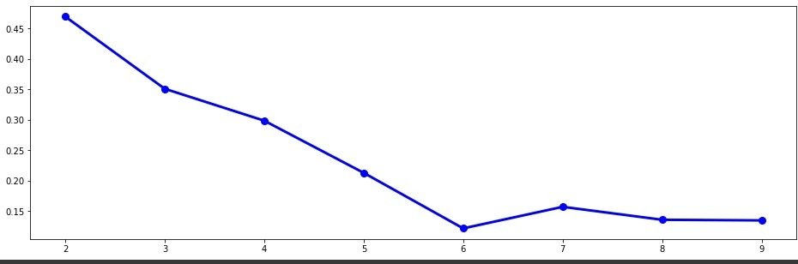
Dash And Dine!
Clustering - KMEANS
ELBOW Score
Silhouette Score

Slide 21

Any Question!
THANK YOU!

